Slide 1
Friday, February 26th 2021
Unit 14: What does he look like?
Lesson 2

Slide 2
A. New words
- Tall- taller
- Short- shorter
- Big- bigger
- Small- smaller
- Old- older
- Young- younger

Slide 3
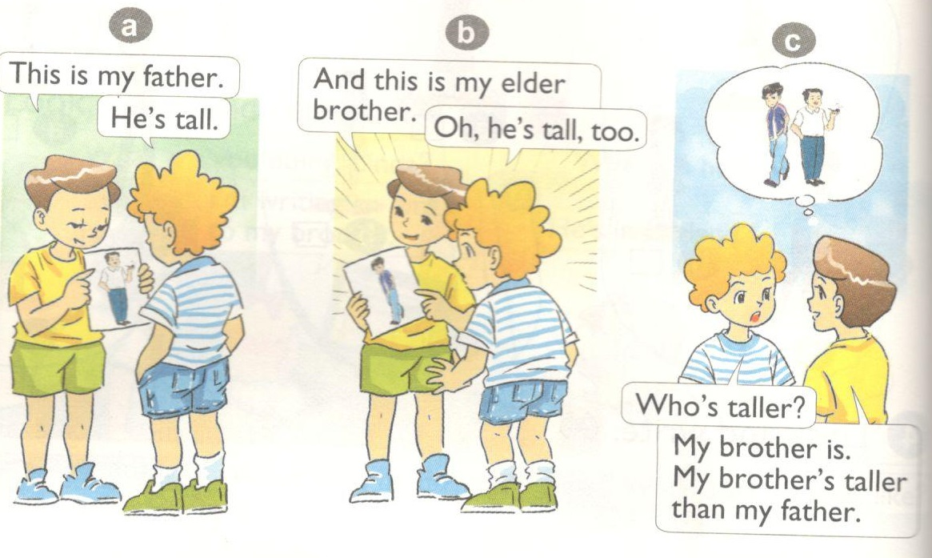
1. Look, listen and repeat

Slide 4
B. Form:
Who’s taller?
My brother is taller.
Ex: Who’s taller, the father or the mother?
- The father is taller than the mother.

Slide 5
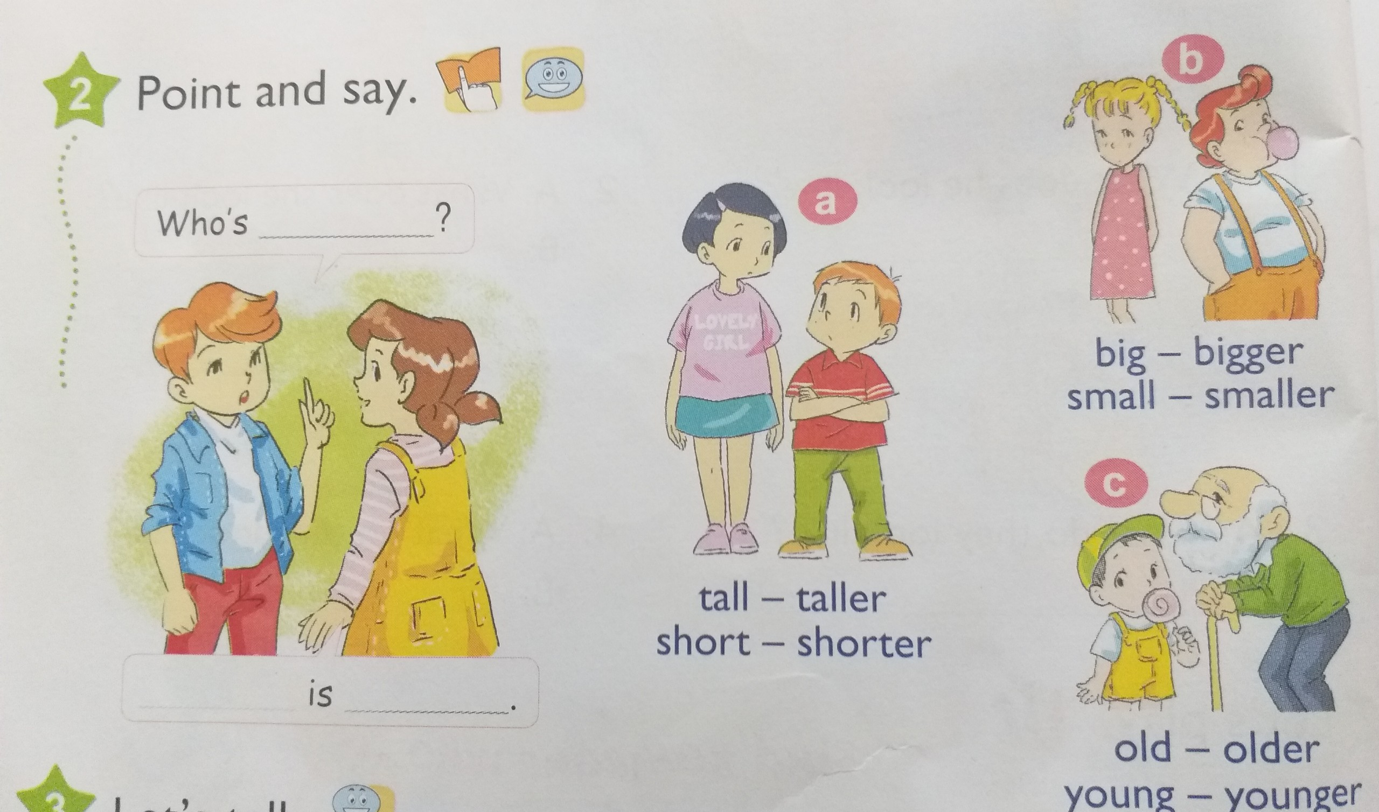

Slide 7
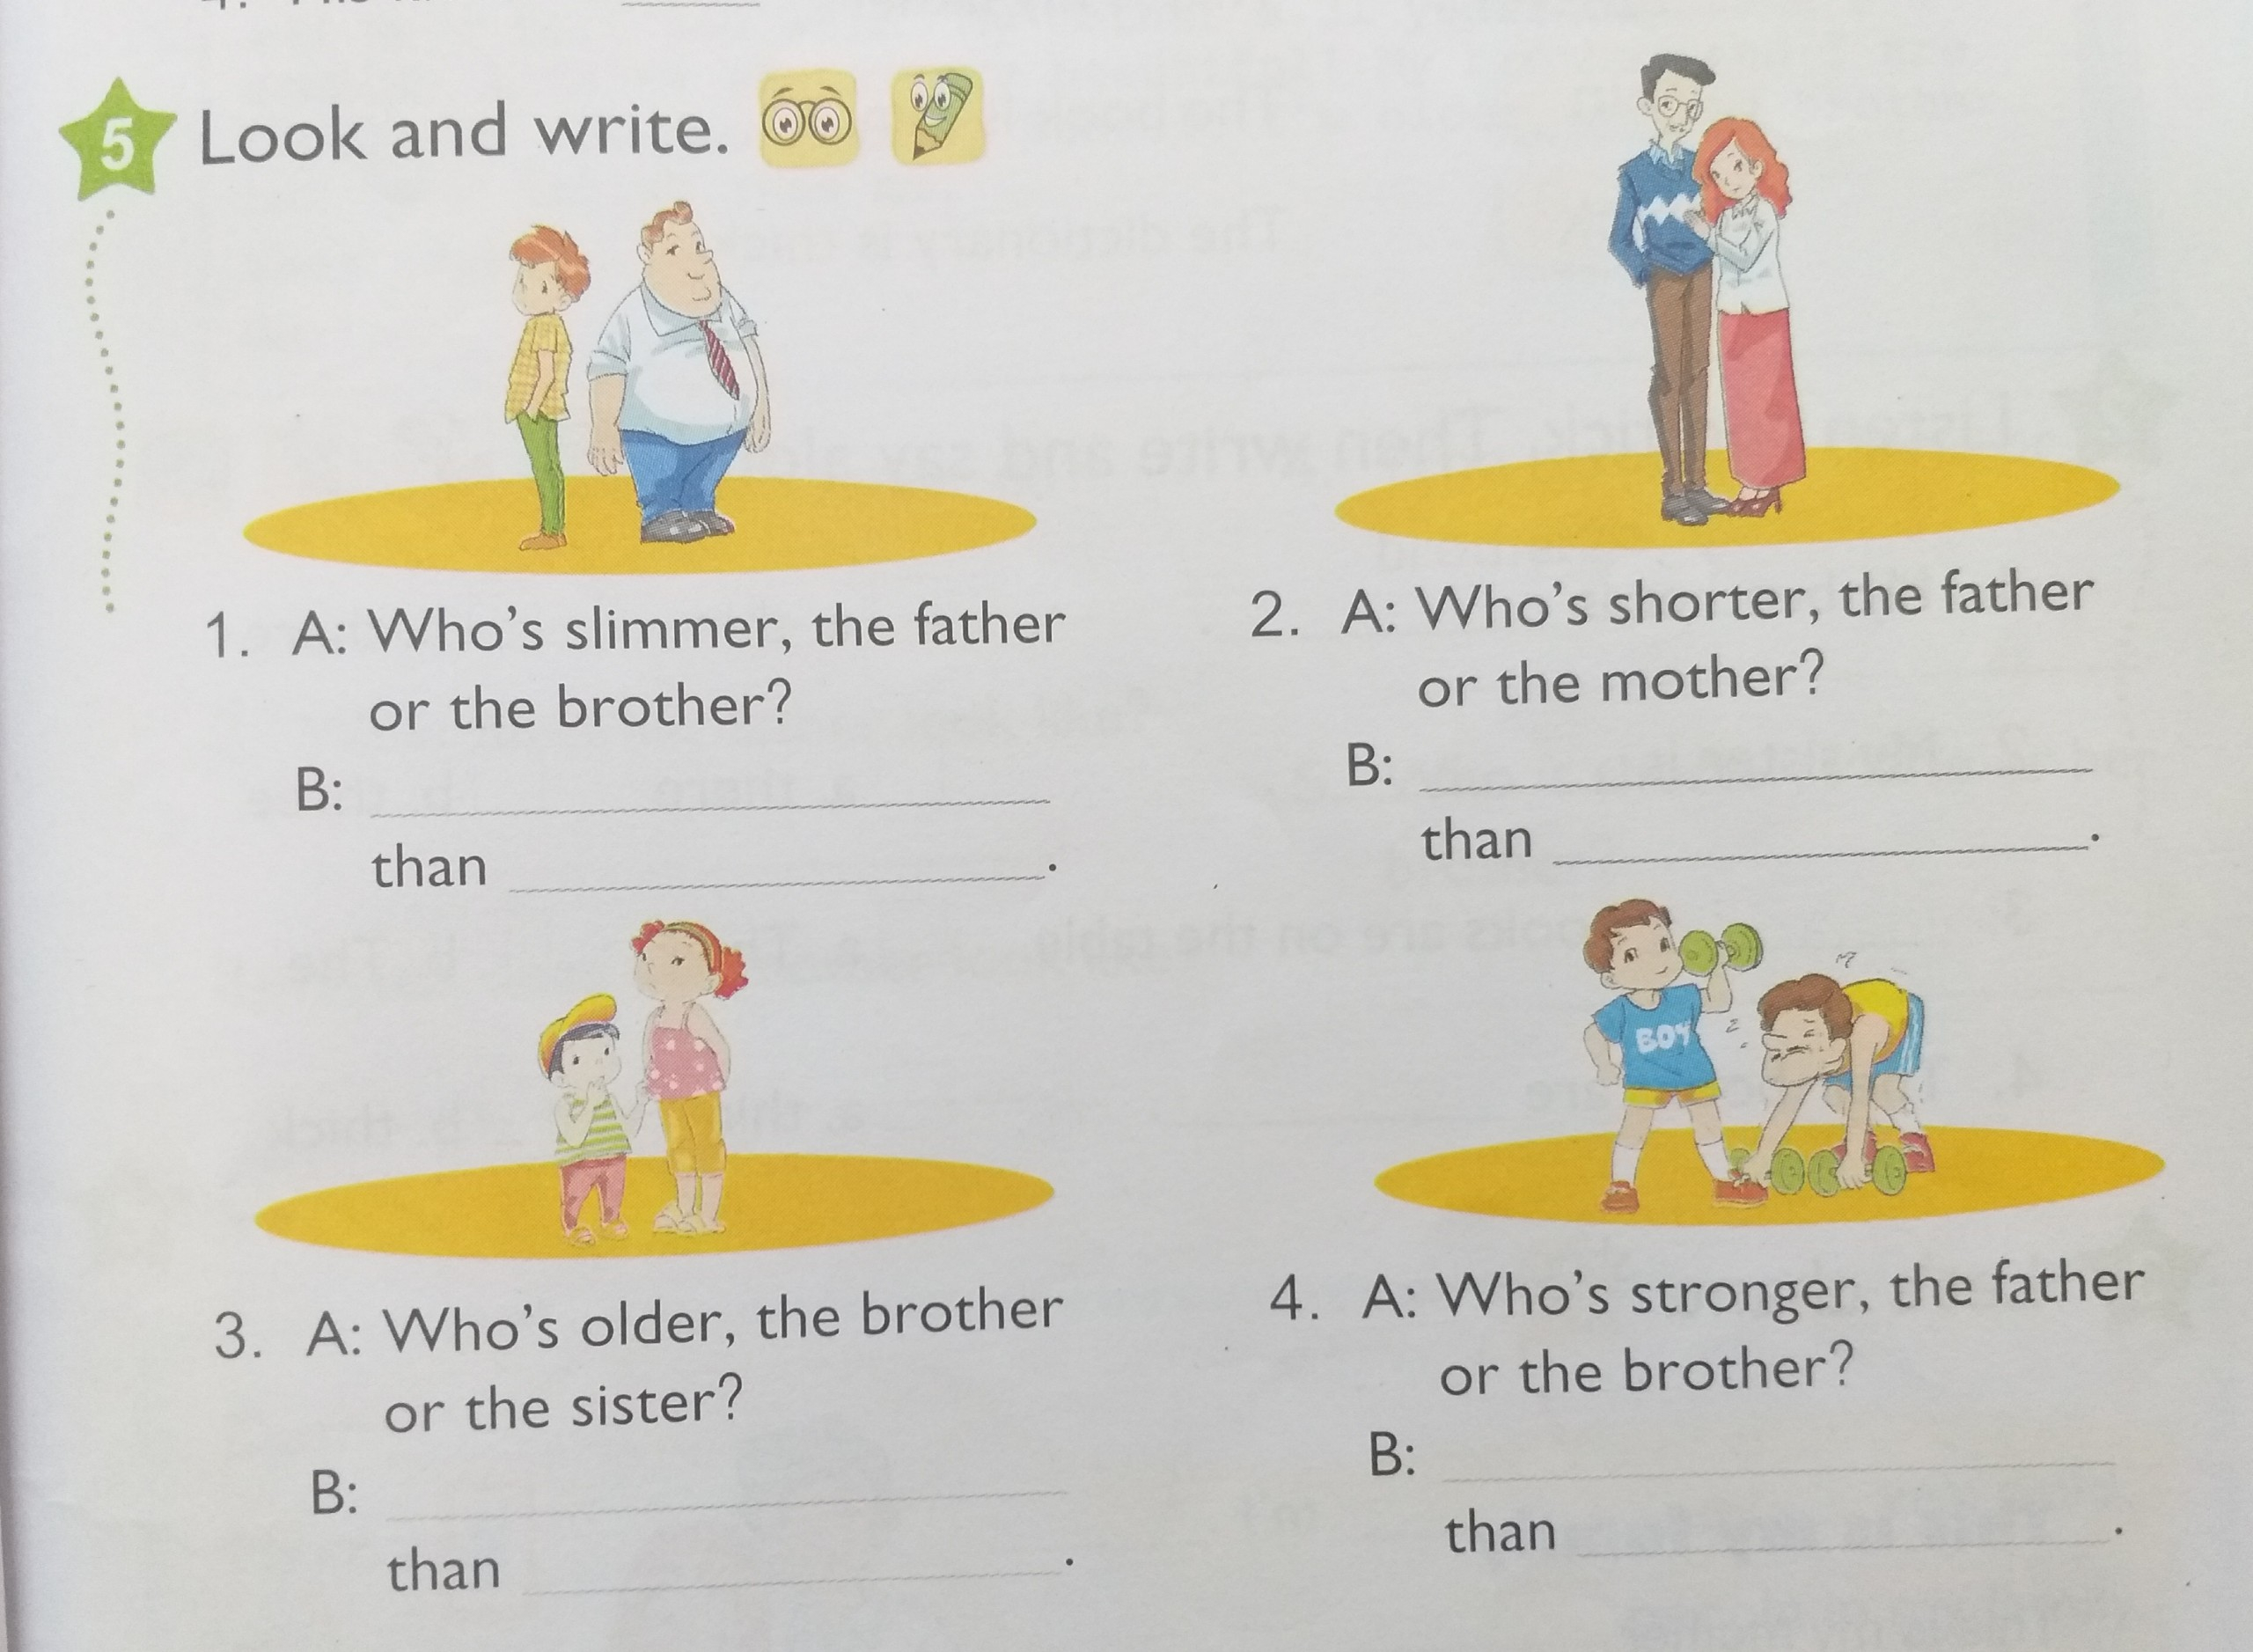
The brother is slimmer
The mother is shorter
the father
the father
The brother is stronger
The sister is older
the brother
the father

Slide 8
Homelink
Learn by heart the vocabulary and the form
Do exercises on WB (Unit 14) and Handout (Unit 14)

